Slide 1
Retailer System By group 9
Team Members:
Aaron Vera Bravo
Junrui Gong
Russi Sinha

Slide 2
Team member Contributions
Aaron Vera Bravo – ER Diagram, DB Schema
Junrui Gong – UI design and implementation
Russi Sinha – Middleware implementation, JDBC

Slide 3
Common features for EMPLOYEES and CUSTOMERS

Slide 4
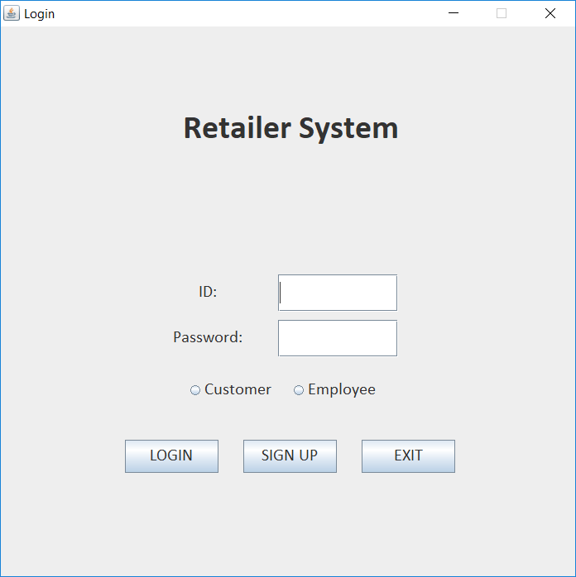
Login | This is the first step of the application where users can login as a customer or an employee. If they don’t have an account, go to sign up (next slide)

Slide 5
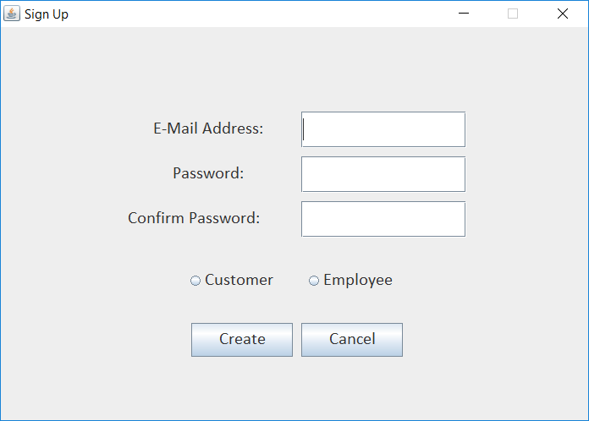
Sign Up | Users can create a new account as a customer or an employee. After creating account, they can login from the login screen (previous slide)

Slide 6
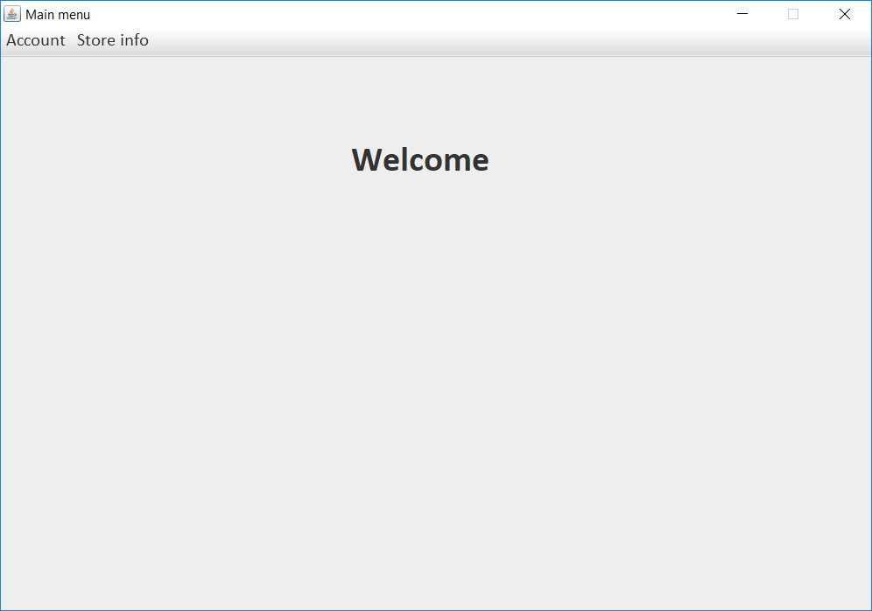
Welcome Screen | This is the landing screen after any user (customer/employee) has successfully logged in.

Slide 7
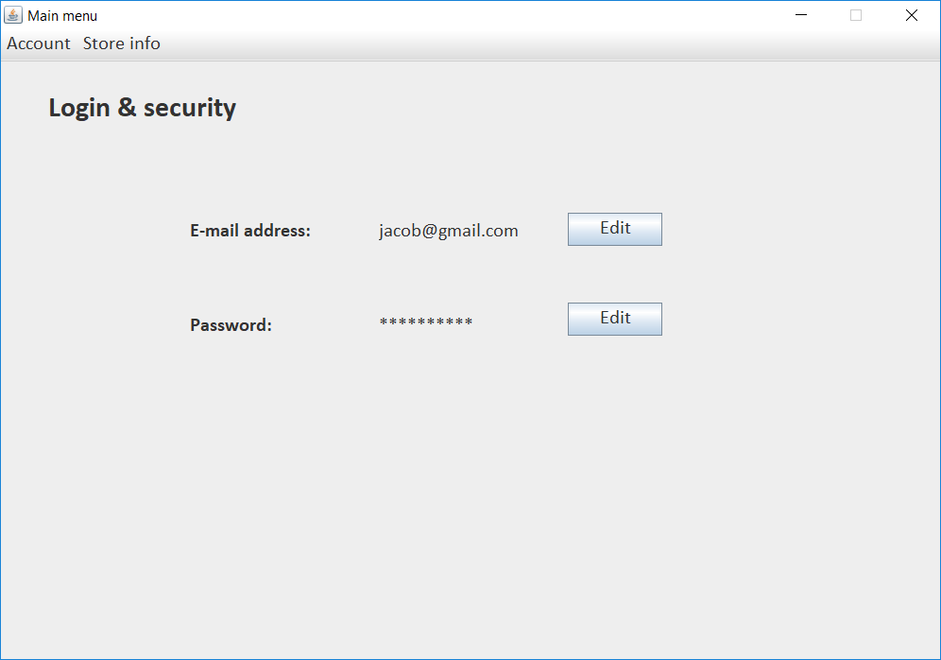
Login and Security | Users are allowed to change their email and password from here.

Slide 8
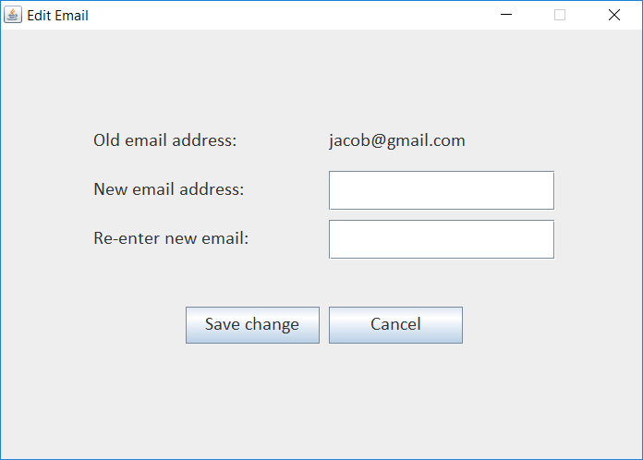
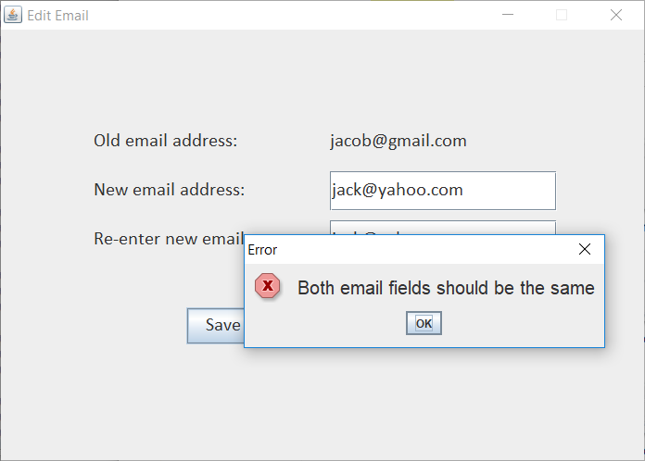
Edit Email | For changing the email, the new email needs to be provided and clicking on “Save” saves the new email to the database. If email does not match in both the fields, it displays an error message.

Slide 9
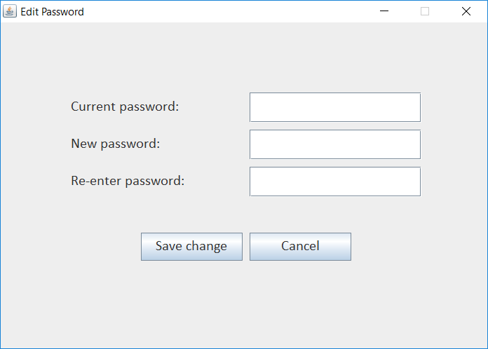
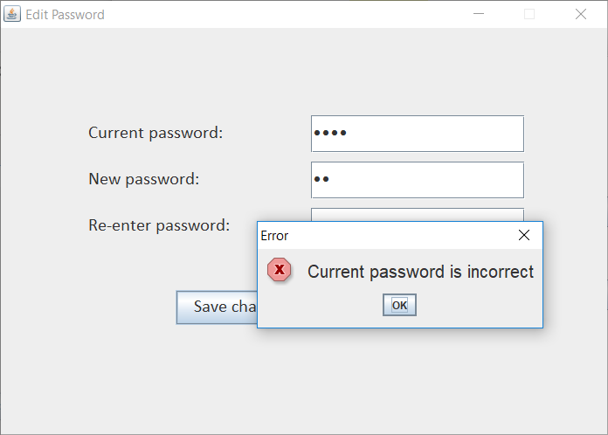
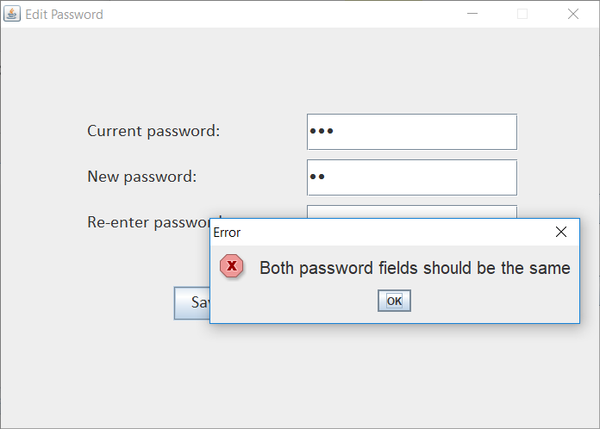
Edit Password | For changing the password, the new password needs to be provided and clicking on “Save” saves the new password to the database. If old password does not match in “Current Password” field, it displays an error message If new password does not match in both the fields, it displays an error message.

Slide 10
Features for EMPLOYEES

Slide 11
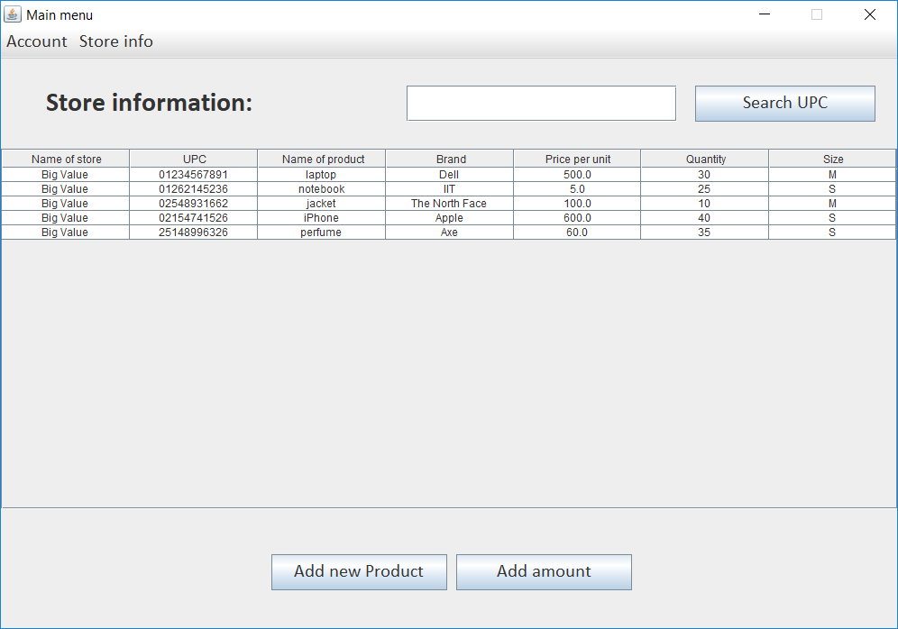
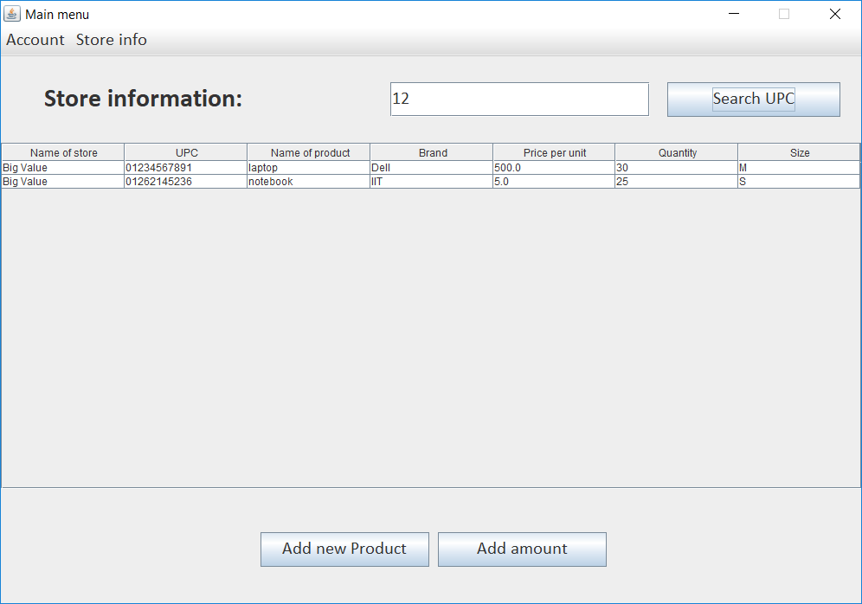
Store Information | This displays a list of all products from all the stores that are currently available. Employees can also filter this list of products based on UPC (partial matching)

Slide 12
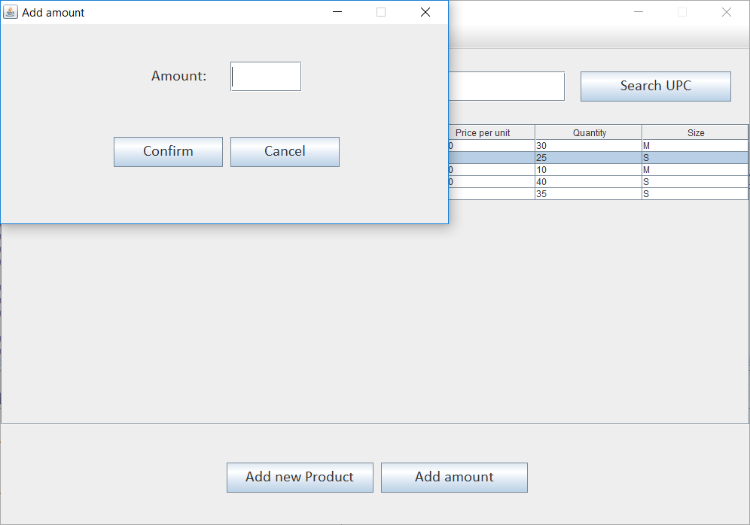
Update Quantity | This allows an employee to update a quantity of any existing product. Note: The value provided by the employee does not replace the old value. Instead it increments the given amount to the old amount (incremental update)

Slide 13
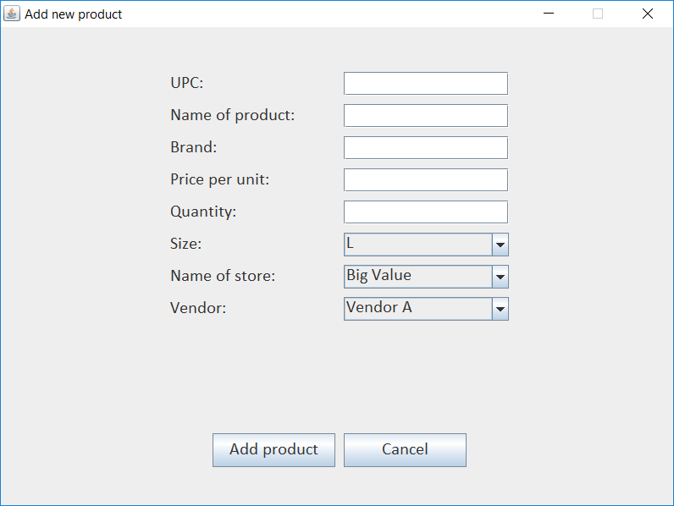
Add New Product | Employee can add new products by providing the details of the product and the store the product is being added to and the vendor from which the store has received the product

Slide 14
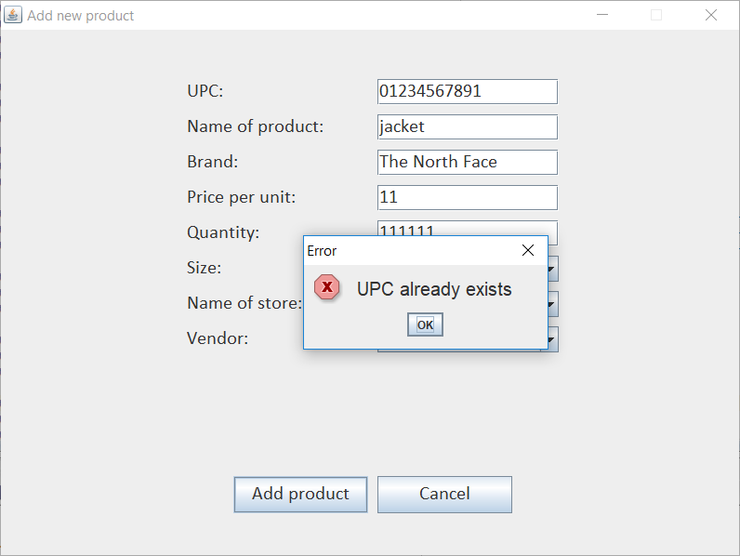
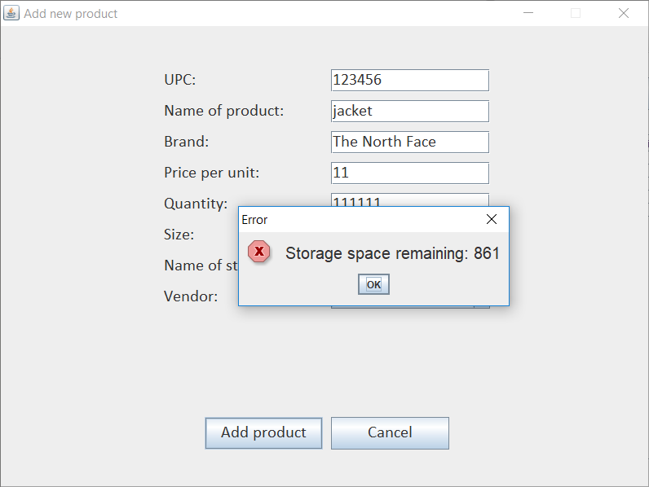
Add New Product (Contd.) | Before a new product is added, the UPC is first checked if the same UPC code exists or not for another product. If it exists, then an error message is displayed. If an employee tries to add an item with the quantity larger than the capacity of the warehouse it displays an error message along with the capacity available for the warehouse.

Slide 15
Features for CUSTOMERS

Slide 16
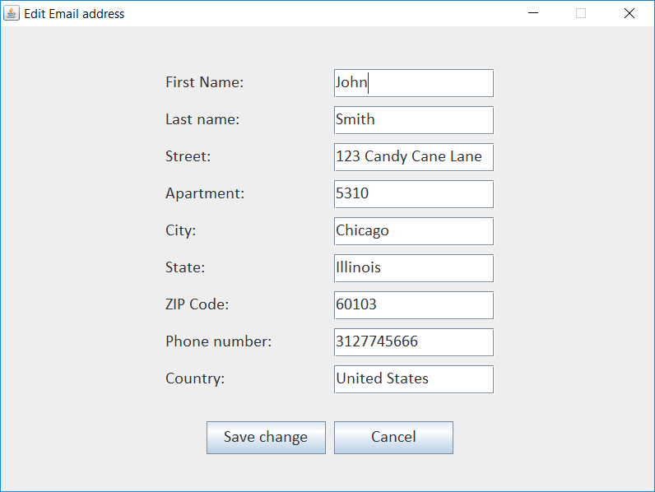
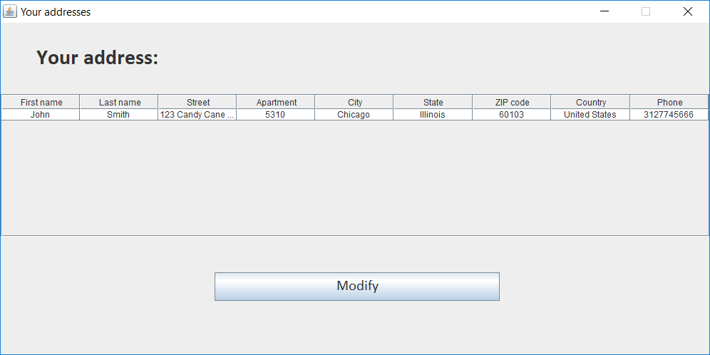
Address | Each customer has an address saved to which they would like to get the order delivered. Customers can also edit their address.

Slide 17
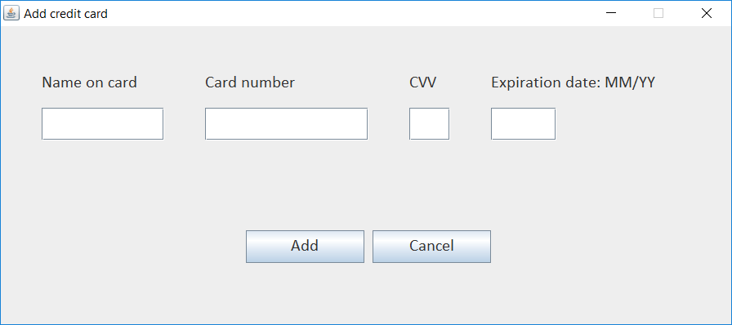
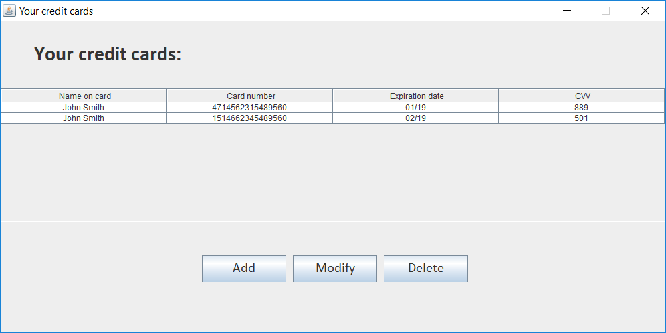
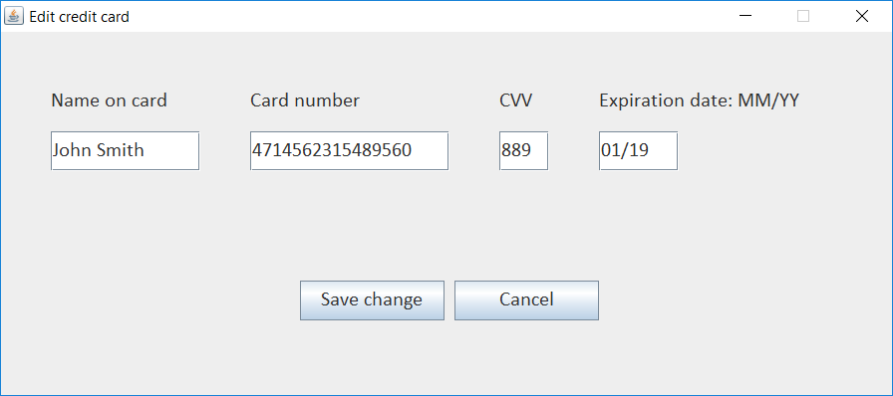
Credit Card | Each customer has a list of credit cards which they have saved using which they can make payments to their purchases. Users can add/modify/delete cards. If customer chooses to add anew card, a blank popup is displayed for user to provide card details. If customer chooses to edit an existing card, a pre-populated popup is displayed with the details of the card which user wants to update.

Slide 18
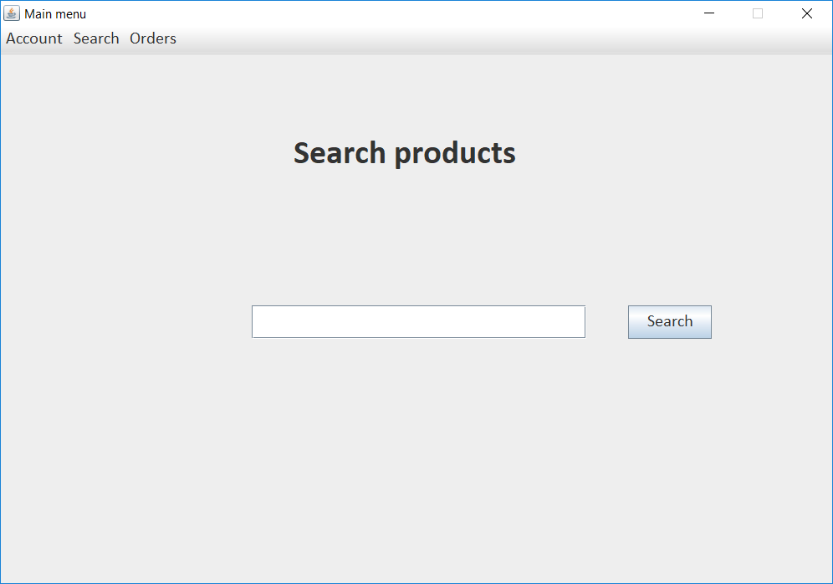
Product Search | Customers can search for a product name from this screen. It is a partial search so if user searches without any keyword, it displays all products.

Slide 19
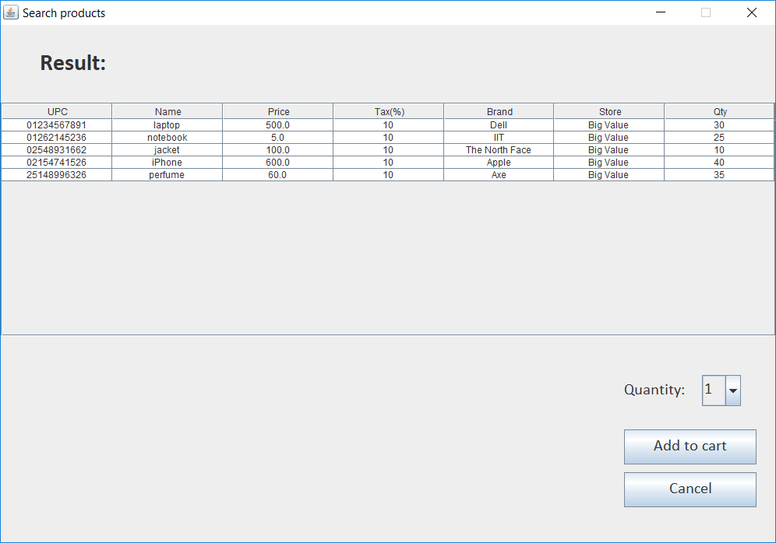
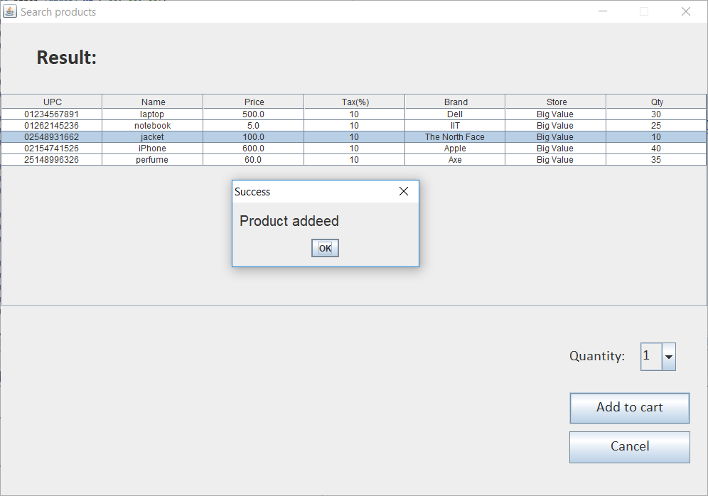
Product List | After clicking on “Search” from the previous slide, a list of products are displayed to a user. Users can add products to cart by selecting a product, choosing quantity and then clicking on “Add to cart”. A confirmation message is displayed after being successfully added to cart. Note: If same product is added to cart again, it does not create a new record, instead updates the quantity of the previously added product.

Slide 20
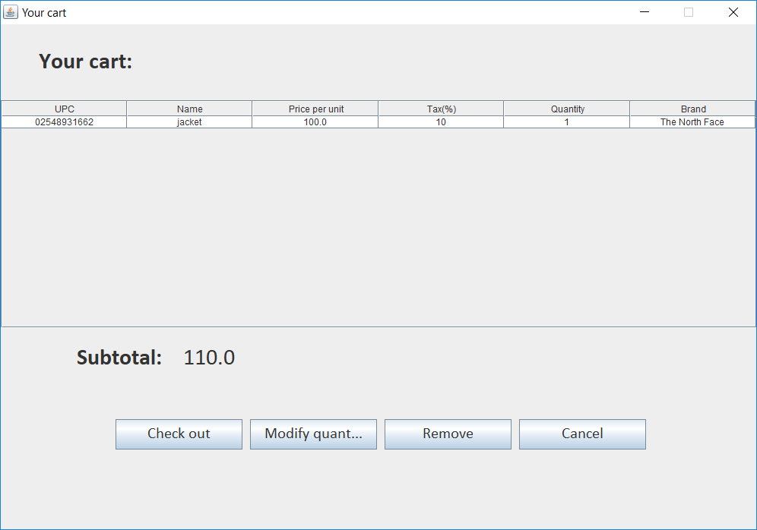
User Cart | This list displays all products which have been added to the cart along with the total amount of all products (including tax). Users can change the quantity of any product. Products can also be removed from the cart by using the “Remove” button. Note: If a quantity of a product is changed to 0, the product is automatically removed from the cart.

Slide 21
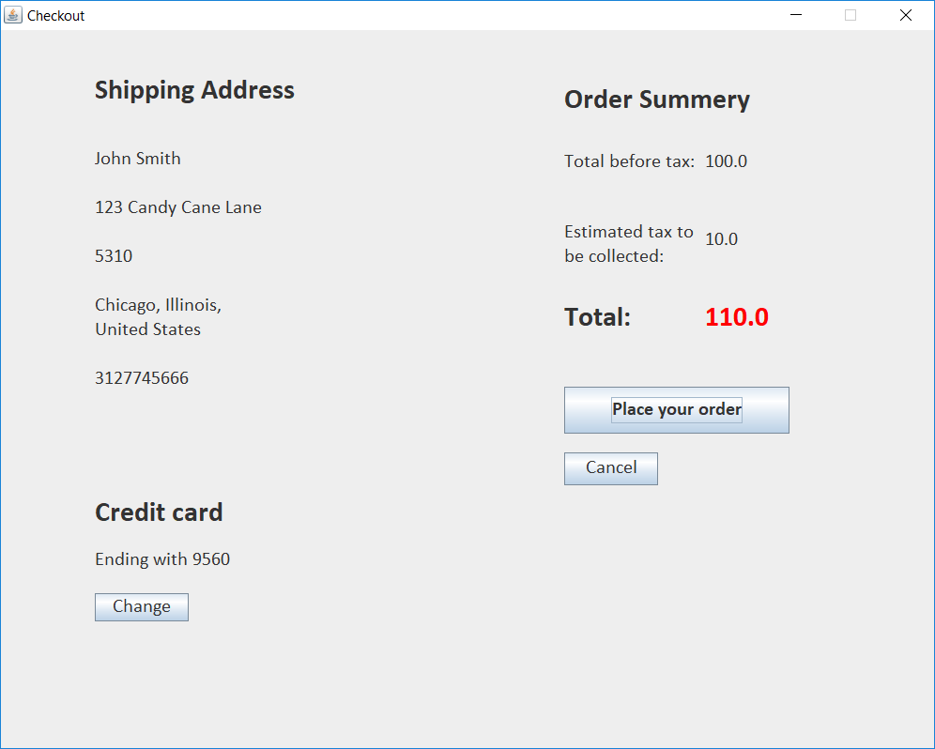
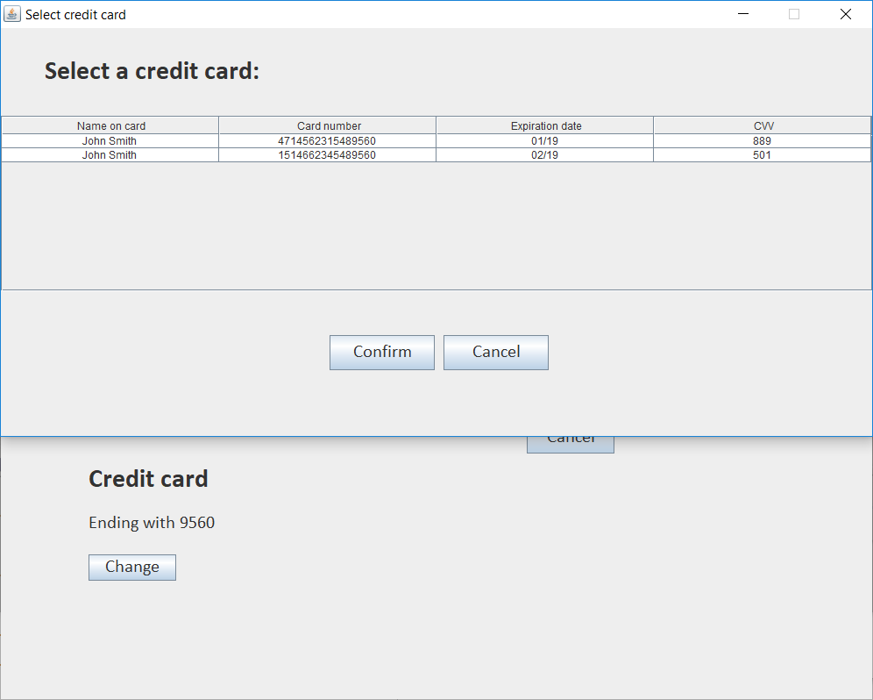
Checkout | When user checks out from the cart, it displays the current address of the user, the credit card details and the total amount of all the products + taxes. Users can change the credit card using which they would like to make the payment.

Slide 22
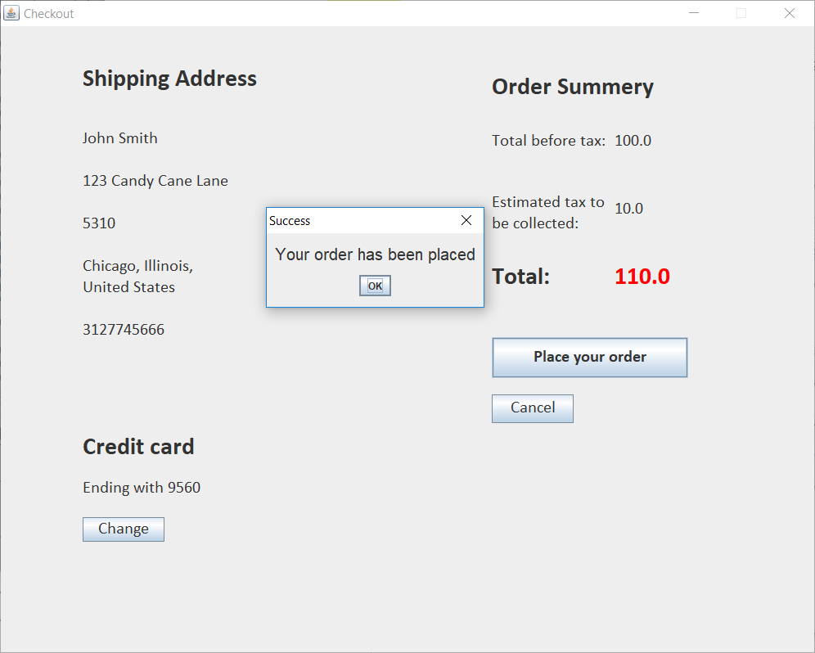
Checkout (Contd.) | After user selects a credit card for payment, user needs to confirm the order by clicking “Place your order”. On dong so, the order will be confirmed and a confirmation message will be displayed.

Slide 23
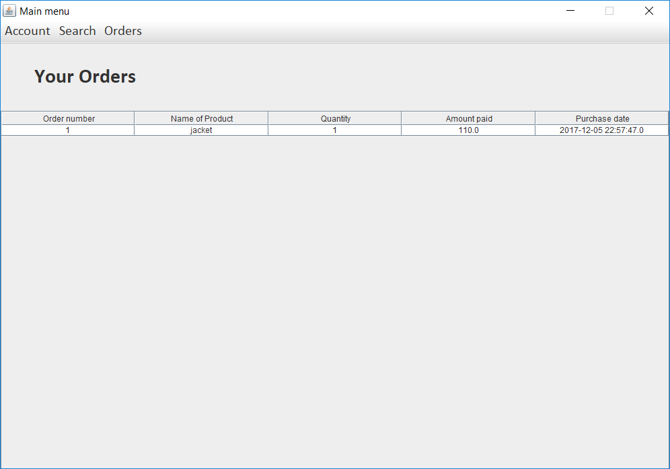
Orders | This list displays all the orders for the logged in customer in the past. It displays the product details and the date on which it was purchased.

Slide 24
THANK YOU

